Slide 1
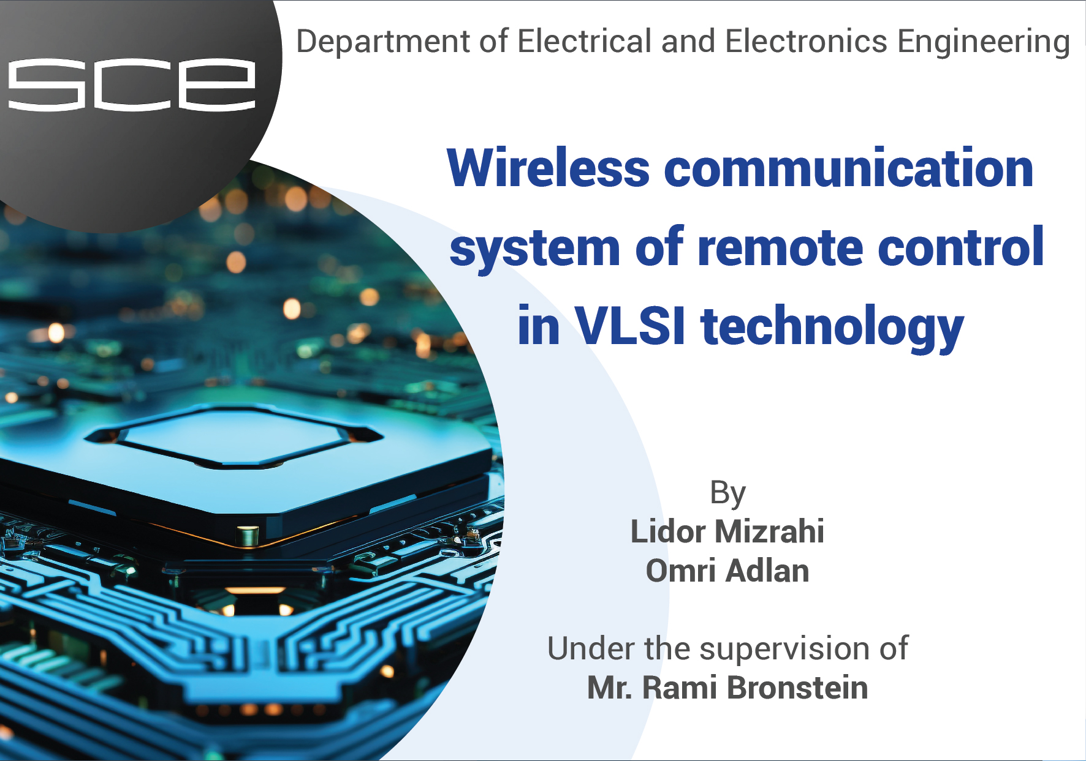

Slide 2

Table of Contents

Slide 3
Project Description and Requirements
The project is to develop a wireless remote-control system when following the requirements:
A wired control interface between PC and an FPGA (UART)
Wireless data transfer
Short and long-range wireless transmission
Error-checking mechanisms (CRC8)
A mobile control interface
Real-time operation
Feedback

Slide 4
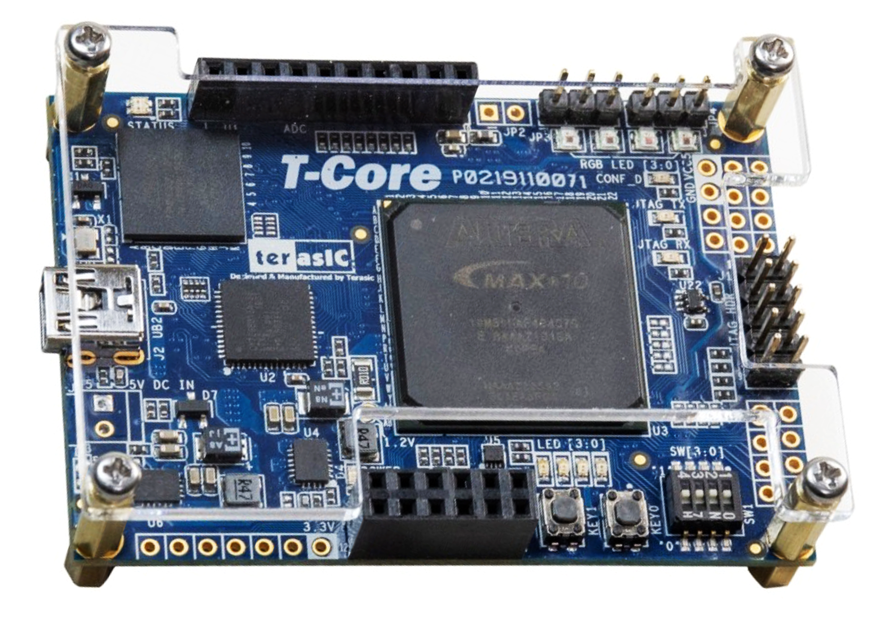
FPGA
Field Programmable Gate Array (FPGA) is a type of digital integrated circuit chip that provides reconfigurable parallel processing capability (VHDL).

Slide 5
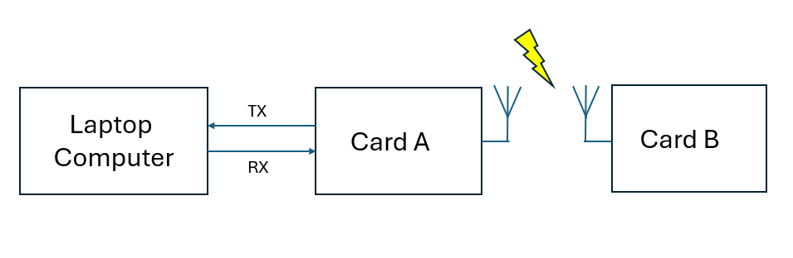
General view of system block diagram
The structure of wireless communication remote-control system with two FPGA cards.

Slide 6
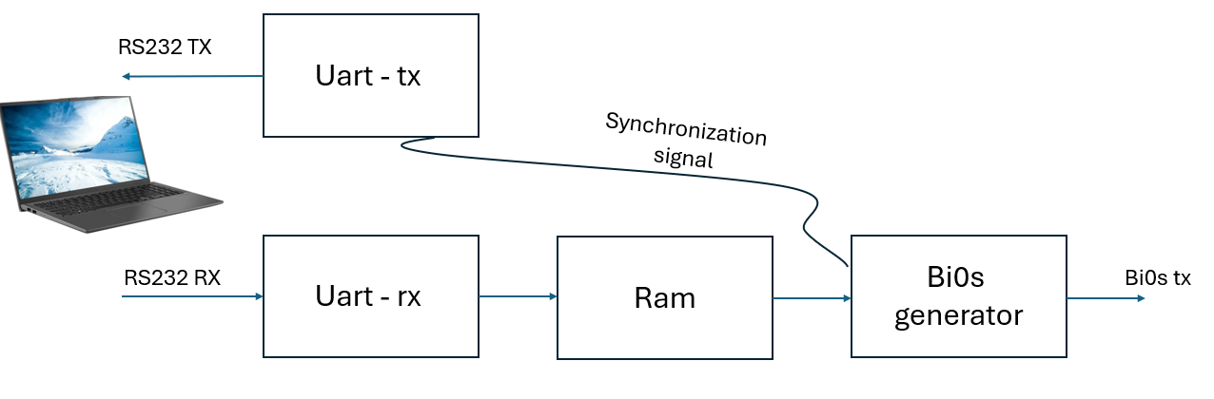
CARD A
Sends a set constant via UART communication to the computer
Receives information from the computer via UART communication and transfer it to RAM
Stores the data received from "Uart_rx" block and forwards it to "BiPhase" block during transmission
Fetch data from the RAM, perform biphase encoding, and wirelessly transmit it to the initial block of card B

Slide 7

UART Communication
How to send the data in UART communication?
An example for UART communication packet:

Slide 8
RAM
RAM 64 Bits
0 0 0 0 0 0
0 0 0 0 0 1
0 0 0 0 1 0
.....
0 1 1 1 1 1
Write Operation
Read Operation
UART_RX
BiPhase Generator
1 0 0 0 0 0
1 0 0 0 0 1
1 0 0 0 1 0
.....
1 1 1 1 1 1
Write Operation
Read Operation

Slide 9
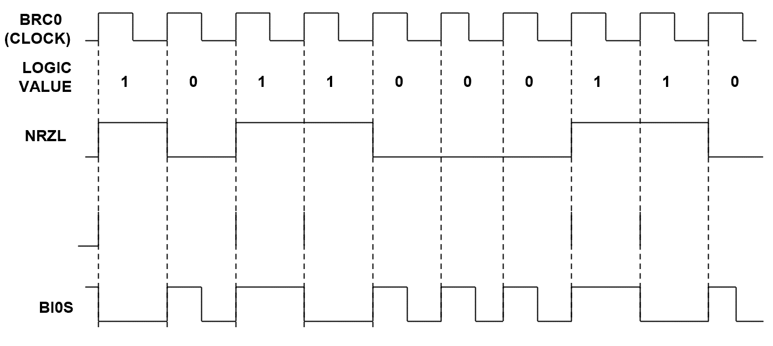
Biphase Generator
How the BiPhase encoding is created?

Slide 10
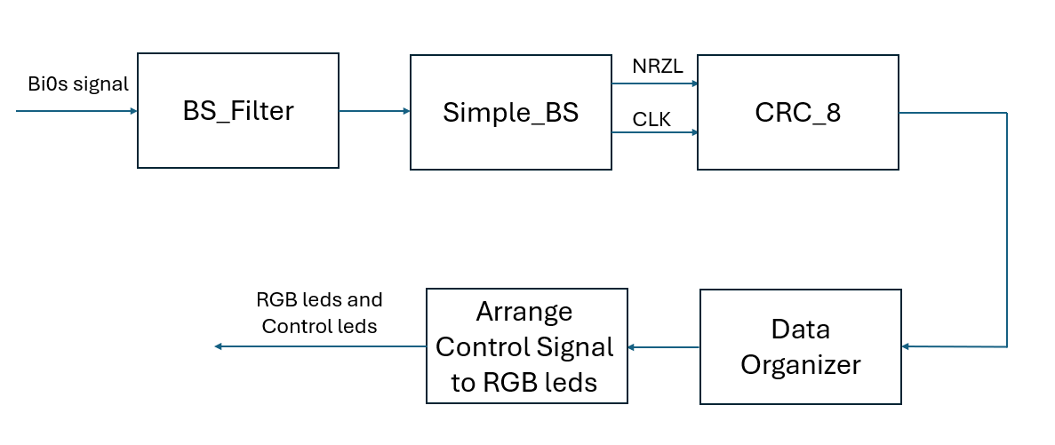
CARD B
Receives the filtered BiPhase signal and produce both transmission clock and decoded data signals
Filter the BiPhase signal from the noises added during the broadcast in the air
Performing the CRC calculation check
Control RGB LEDs, enabling the display of colors and patterns.
Data organizer and CRC checker for incoming data streams.

Slide 11
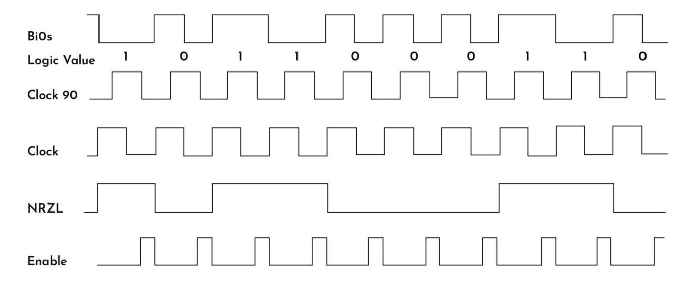
Simple_BS
How the BiPhase decoding operation is created?

Slide 12
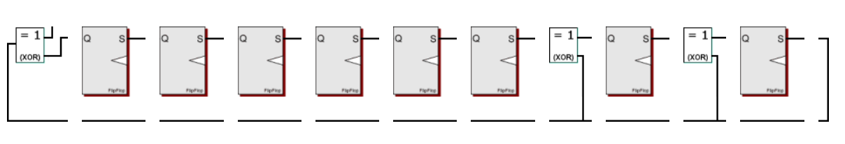
CRC8BIT
An example of CRC-8 RTL algorithm transitional diagram:

Slide 13

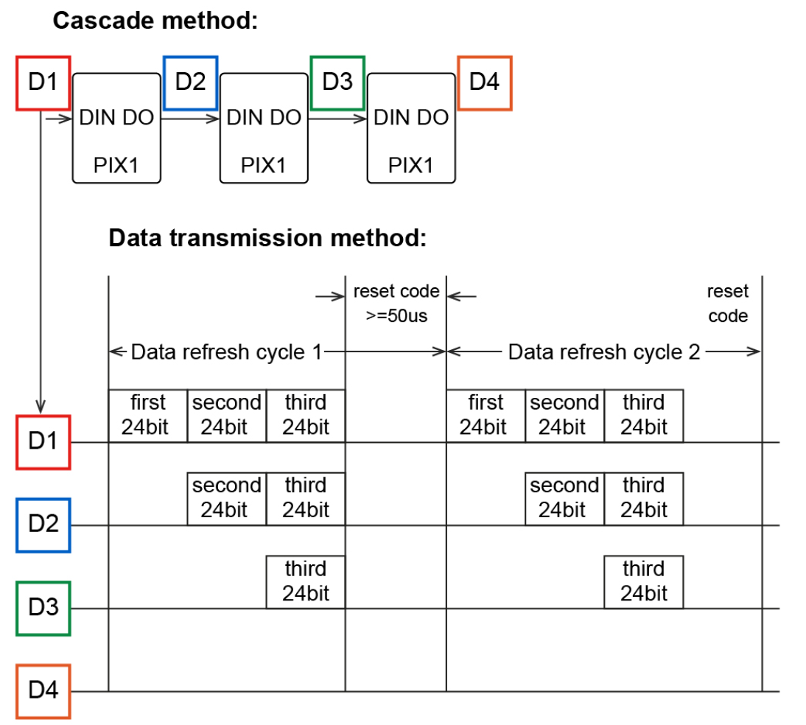
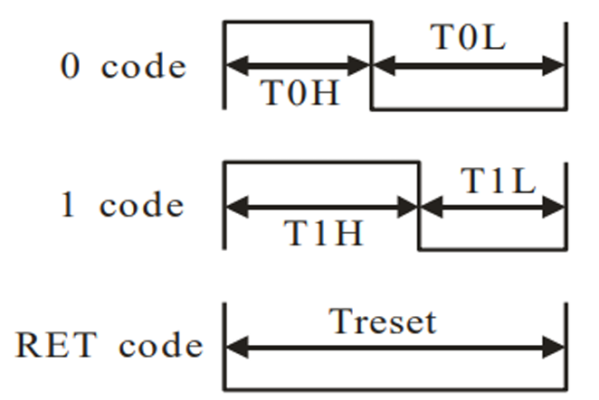
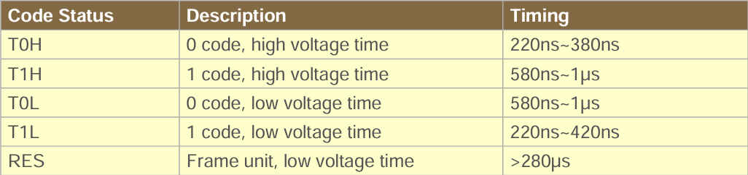
RGB Led
Data Transmission Method
Code Timing
Sequence Chart

Slide 14
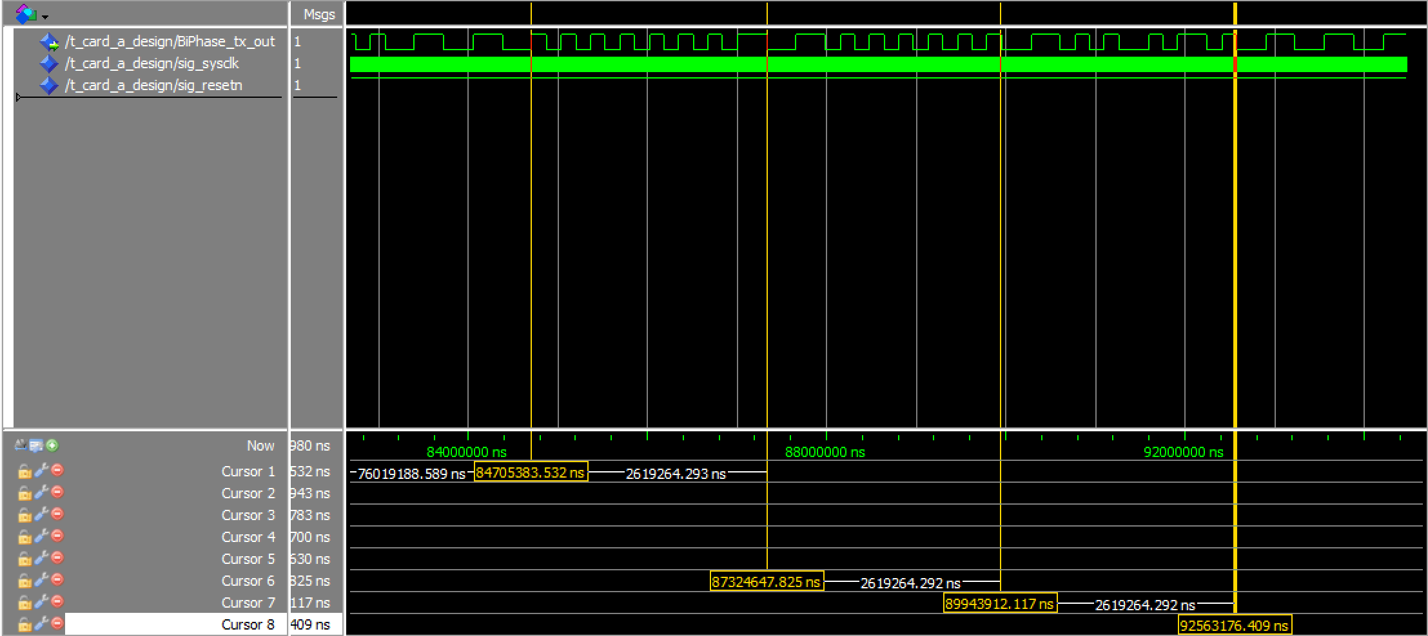
Test simulation: Card A
Using ModelSim simulation we can validate the data transfer pathway in card A and card B
We utilize a code name "Card_A_Design" that connects the 4 blocks: "Uart_tx_Rom", "Uart_rx", "Ram2_X", "BiPhase_tx"

Slide 15
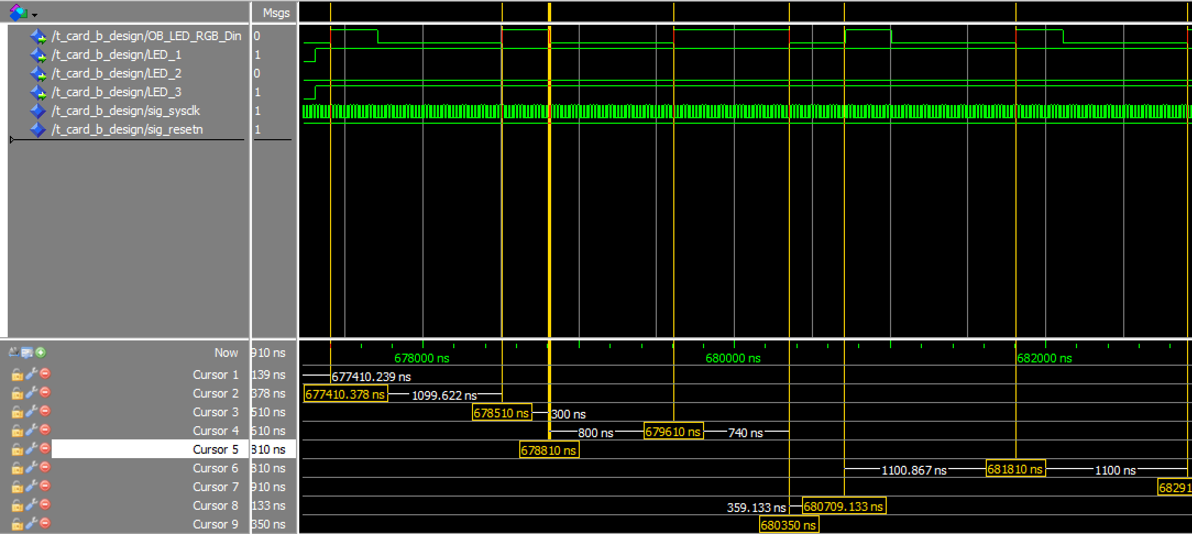
Test simulation: Card B
We utilize a code name "Card_B_Design" that connects the 6 blocks:
"BiPhase_Generator", "BS_Filter", "Simple_BS", "CRC8BIT", "Data_Organizer", "RGB"

Slide 16
Conclusion
Wireless communication systems based on FPGA cards are highly beneficial for various industries.
The system outlined in this presentation enables wireless communication between two FPGA cards: Card A and Card B. The computer running an application that allows a user to control data transmission.
The testing process of the system allowing thorough examination of all its components. Test results closely match between the theoretical calculations to the information transfer times and synchronization between units.
However, a notable drawback arises when testing signals with low frequencies, leading to longer simulation times. To mitigate this issue, it's necessary to increase frequencies solely for simulation tests or utilize more powerful computers for faster information processing.
During field tests, it was observed that the transmission speed decreased as the distance between the transmitter and receiver increased. For short-range communication, the system was tested up to 60 meters, beyond which the information could still be received but with considerable delay.
In future iterations of the system, incorporating an encryption unit will be a crucial enhancement. This encryption unit will serve to encrypt the information transmitted through the system, ensuring its confidentiality and integrity.

Slide 17
References

